Slide 1
MAP/UPP and Managing Online Resellers

Slide 2
CHRIS GRAY – CEO of BRANDWOVEN
18 Years experience working with large, premium brands
6 Years leading Brandwoven (Formerly Run AMZ)
Managed over $1.7B in collective consumer sales of sporting goods products across multiple channels
Experience in big box, specialty retail, 2-Step distribution and D2C channels

Slide 3
ABOUT BRANDWOVEN
28K
ASINS managed
$175M
Amazon sales managed per year
Brandwoven is a full-service marketplace management agency dedicated to helping premium brands thrive on Amazon, Walmart.com, Target.com, and other online marketplaces.
Our services cover every corner of the digital marketplace including catalog management, digital merchandising, logistics, marketing, and more.
Our approach is consultative and we value long-term partnership and brand stewardship over everything else.
Learn more at www.gobrandwoven.com
$16.8M
Avg annual Amazon sales of Vendor Central brands
32
Staff

Slide 4
WHAT WE WILL COVER
Objectives of UPP/MAP and Managing Resellers Online
Foundational Knowledge for Managing Resellers
Management Framework & Creation
Authorized Reseller/Distributor Programs
Pricing Policies
Enforcement Framework & Creation
Tracking & Data
Legal Action vs Other Enforcement Methods
Common Roadblocks
Frequently Asked Questions
Q&A
DISCLAIMER: The information presented in this webinar is for informational purposes only and does not constitute legal advice. The content shared is not intended to replace consultation with a qualified attorney. Please seek professional legal counsel for advice tailored to your specific situation.

Slide 5
FRAMEWORK
Participants are muted and cameras turned off but feel free to ask questions
Use Q&A button at top right of screen at any time
We will try to answer questions real-time but may elect to wait until end of presentation
Presentation planned for 40-50 minutes
Link to the webinar will be posted online within 48 hours

Slide 6
WHAT ARE WE TRYING TO ACCOMPLISH
STABLE PRICING
CHANNEL CLARITY
CLEAR CONSUMER JOURNEY
Most premium brands want to see consistent pricing across all channels of trade, but the arbitrage model on Marketplace gets in the way. The only way to manage pricing across channels is for brands to take an active role and engage across the ecommerce ecosystem
Brands today want to establish the unique attributes of each channel of trade, what consumers each channel is attracting, and have tools to manage each channel from product development to end use
With shoppers having easier access to all retailers simultaneously via shopping apps and marketplaces like Amazon, managing the consumer journey becomes vital to preventing distractions and increasing conversion

Slide 7
Foundational Knowledge
Why is Brand Protection So Challenging?

Slide 8
FOUNDATIONAL KNOWLEDGE – BUY BOX

Slide 9
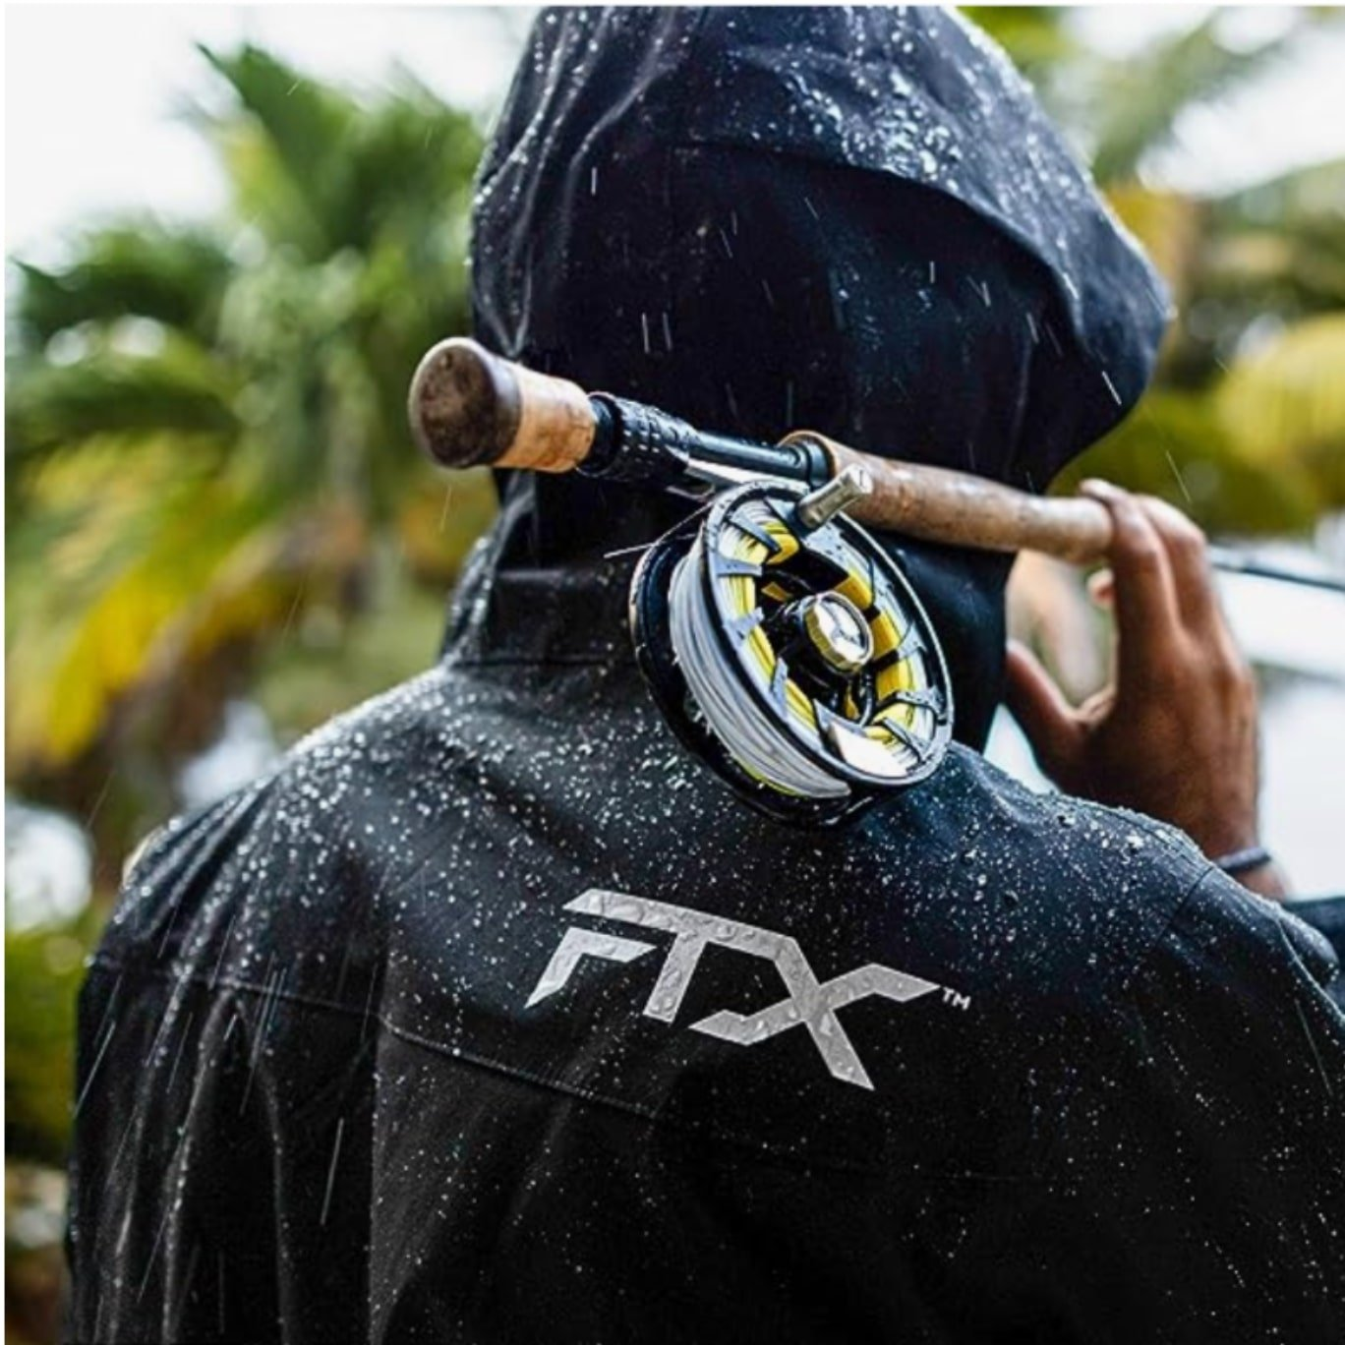
How Marketplace Resellers Obtain Product
Direct from Brand
Distributors
At Retailers on Discount
Dealers or Retailers
Return Pallets & Liquidators
D2C on Discount
Many resellers buy product direct from the brands and resell online under different names to hide themselves from the purview of the brand
Industries where 2-step distribution is common often have the most challenges because distribution to dealers, or even Amazon Vendor Central is invisible to the brand
There are millions of shoppers who travel into retail businesses to find discounted products that can be resold on Amazon. Using apps to calculate profit on the spot, it is a near certainty that deeply discounted products will wind up on marketplace
It is all too common for consumers to have a partnership with a dealer or retailer to purchase product in build, on discount to resell on Amazon
There are dozens of retailers who sell pallets of used product or new product at liquidation prices. Even if against Amazon TOCs, this product often ends up sold as new on Amazon
Deep deals through D2C will often be purchased in bulk by consumers and show up on amazon a few weeks or months later

Slide 10
Typical Marketplace Supply Chain
Challenges of Typical Supply Chain
Amazon currently has over 9 million sellers worldwide, with thousands of ways to procure product.
Brands have pressure and often bad actors from all levels of the supply chain
What happens in one channel of trade is closely linked to another
Consumers, dealers all have an outlet to reach millions of consumers (Amazon)
Notes:
Example of when product went to sister-in-law

Slide 11
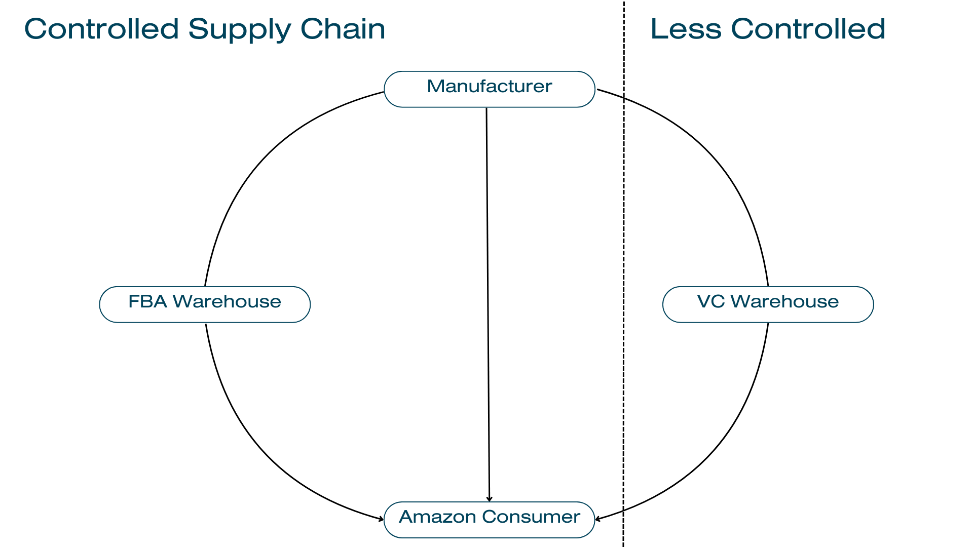
Managed Marketplace Supply Chain
Importance of Managing Supply Chain
With Amazon giving access to millions of sellers, brands have to take an active role in who and where product is distributed
Brands have choices as to how, but control is a necessity
Multiple unknown sellers limit opportunity on marketplace and damage other channels of trade
Brands should be as close as possible to their end consumer
Notes:
Remember to discuss picking your partners if you’re going to let others sell.

Slide 12
Amazon Won’t Solve Reseller Challenges For You
No major marketplace currently offers programs to effectively manage resellers or pricing.
It is in Amazon and other marketplace’s best interest to allow for competition
Legal implications for marketplaces to control pricing and/or resellers
Programs like Transparency are designed to manage counterfeits and gray market vs help with channel control

Slide 13
Structure for Successful Reseller Management
Policies & Agreements Needed for Brand Protection

Slide 14
Framework for Management
UPP Pricing Policy
For known and unknown retailers
Authorized Distributor Program
For partner distributors
Authorized Distributor Program
For partner distributors
Authorized Reseller Program
For partner retailers
Established Material Difference
Difference between unauthorized & authorized product for legal recourse of bad actors
https://casetext.com/case/otter-prods-v-triplenet-pricing-inc

Slide 15
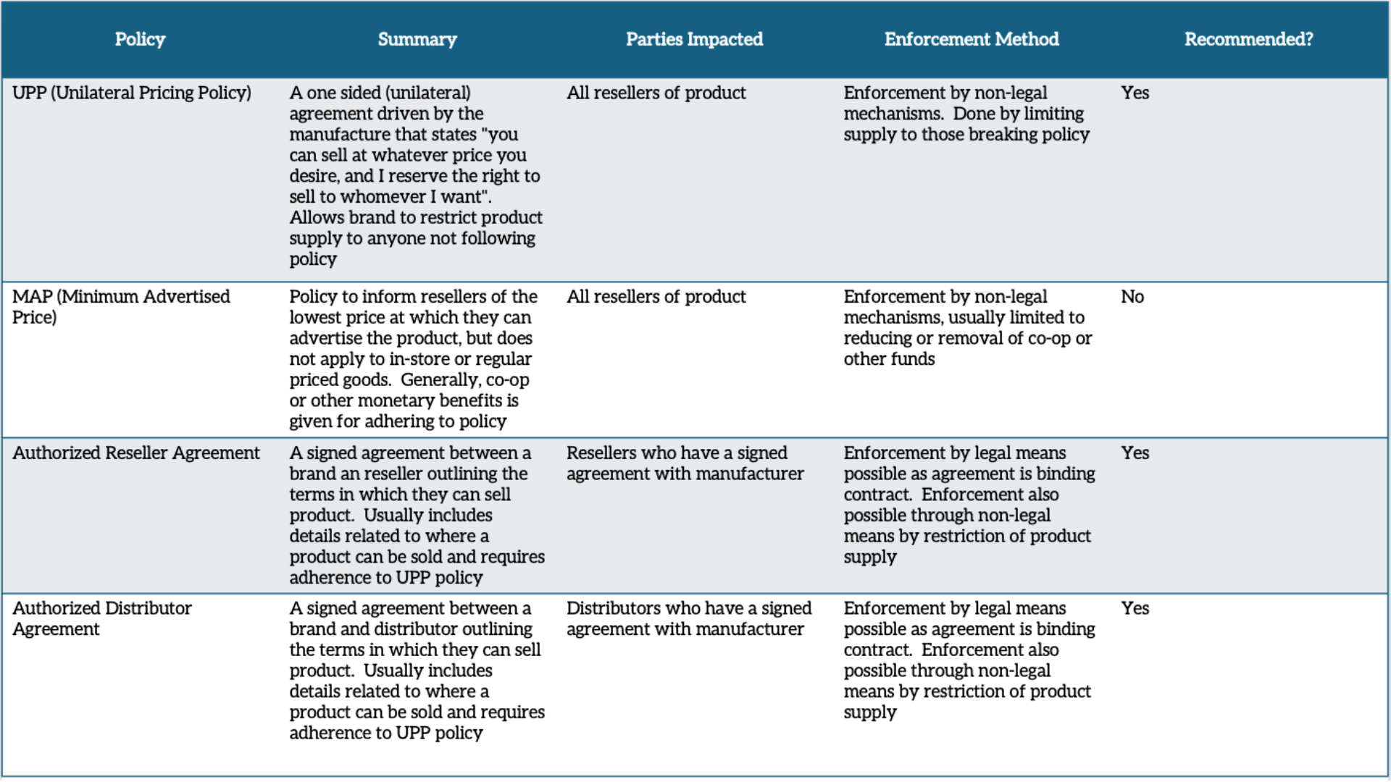
PROGRAM OVERVIEW

Slide 16
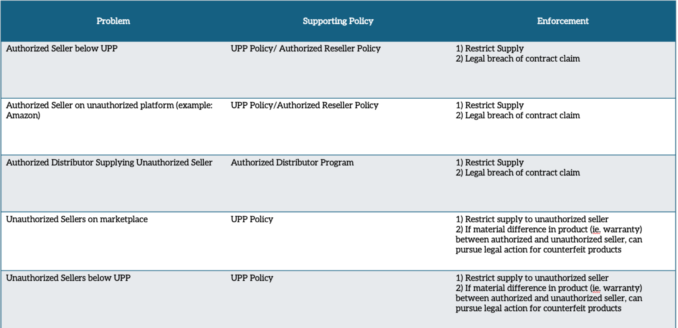
How Policies & Agreements Address Common Problems

Slide 17
Management & Enforcement
How to Create & Enforce Brand Protection Programs

Slide 18
Resources for Implementation & Management
Internal Support
Internal Person(s) to quarterback programs, confirm enforcement & facilitate authorized program details
Tracking Software
Software service to track resellers across all online distribution channels & report on infringement
Legal Services
Draft, train and assist with implementation of policy documents & enforcement.

Slide 19
Internal Resources
UPP & Authorized seller programs require internal resources
Executive sponsorship and support is key to success
It takes the internal team being bought in, and the work is never-ending
Program Administrator
Often an internal sales lead who can build the program, administer the authorized sign ups, and push enforcement
Executive Sponsor
Every successful program must have buy-in from Sr. leadership. Without it, the conflicts within companies rarely allow the programs to become successful

Slide 20
Legal Services
A solid legal framework for all policies and programs assures defendable agreements and avoids inadvertent anti-trust and anti-competitive behavior
What they do:
Draft program documents
Train sales staff
Assist with daily enforcement strategies including document prep
Take legal action when necessary
Services we’ve worked with:

Slide 21
Tracking Software
Tracking software is an essential piece to successful programs because it can track and organize violators, measure improvement, and serve as a layer of enforcement.
What Can it Do?
Scan the entire ecommerce ecosystem daily
Dashboard and document violations
Assist in program administration
Gain access to database of known sellers
Software we’ve worked with

Slide 22
Amazon Programs for Brand Protection
Other programs that are often understood as tools to manage resellers & pricing policies
While often used for this purpose, the use of ABR or Transparency for resellers control is often against TOCs within Amazon and not the intended use of the programs
Program to assist with brand ownership and trademark infringements but does not impact resellers or price
Program that allows brands to add transparency code (Amazon developed serial number) for each product with the commitment that Amazon won’t allow product without a code to be sold. Used for counterfeits but has been utilized for reseller management, although against TOCs of the program

Slide 23
Common Roadblocks
Lack of Commitment From Brand
Misalignment of Internal Goals
Untrustworthy Partners
Ineffective Program and Policy Design
Fear of Reaction From Partners
Cash Impact of Implementation
Far and away, the number one hinderance to successful reseller and UPP policy is wavering commitment from the brand. In a classic example, management is running smoothly but it’s the end of the quarter and a known bad actor offers to buy millions to help with quarter close and makes the sale, leaving months of inventory in the hands of a retailer selling below UPP.
The most common misalignment we see is between sales leaders and sales reps. Amazon is significant business for many dealers, and many times salespeople are motivated to continue to drive volume into small dealers who have been previously cut off.
All brands have a set of excellent partners that they can trust to help grow their business and reach new customers. But even partners with years of relationships are willing to bend the rules in search of margin or sales growth. This often means breaking policy. We advise all brands to ask for open reporting and communication from trusted partners to avoid unexpected problems.
Having well written policies and agreements is key to success not only for their enforceability, but for the ease of retailers and distributors to follow the rules. It is not uncommon to have well-meaning partners mis-interpret unclear or poorly communicated UPP or authorized retailer policies.
Whenever programs are implemented or changed, fear of negative reactions from retailers can stymie reseller management efforts. It’s essential that brands are confident that their programs, for good partners, help protect their business and yours. Dealers who only compete on price, and only use marketplace will react negatively, but they are low value dealers to the brand.
The reality of implementing consistent authorized reseller and UPP programs is that it can have a short-term impact on cash. Existing un-authorized dealers will need to sell through inventory before a brand can take over, and that time leaves a gap in sales revenue and cash. While the total sales through platforms will still increase, timing becomes an issue for some.

Slide 24
Common Questions
Question: If I remove resellers and implement a program like this, will I lose sales?
Answer: While one of the greatest fears of many brands when consolidating resellers, the reality is that gross sales almost always increase, as additional resellers bring no incremental traffic or value to marketplace and fewer sellers or brand driven sales can almost always result in increased revenue, customer experience, and ROI.
Question: Why is this necessary, if I get the sale regardless?
Answer: The short answer is that rarely can multiple sellers generate the same volume, and with the same level of customer care as a single focused entity. With very few exceptions, margin and overall sales volume is improved, as is brand integrity with none or extremely limited distribution on online marketplaces outside of the brand.
Question: How will my dealers/distributors/partners respond?
Answer: Generally, dealers and distributors are familiar with these sort of programs. Their response tends to be reflective of the value they place on your brand. Partners who are adamantly opposed to authorized programs and UPP policies are generally the partners that bring your brand little to no value. - whereas partners who embrace the programs value your product, equity in pricing, and see your efforts to remove rogue and unauthorized sellers from marketplace as a huge boon in their business, as they always have been looking out for your brand.

Slide 25
Common Questions
Question: What if my distributors won’t play ball?
Answer: Unfortunately this leaves a brand with a tough choice. If the distributor is vital to supplying other channels of trade that can’t be replaced by a better partner, other methods need to be used to control behavior on Marketplace. This can include structuring pricing in such a way resellers buying through distribution can’t compete, building marketplace exclusive SKUs suited for online sale that are not given to distribution, or abandoning UPP pricing and committing to win the buy box at the market established retail price.
Question: What’s a realistic buy box % and UPP adoption to expect?
Answer: With such a globalized market, it is unrealistic to expect buy box and UPP adherence to be consistently over 90%. Best-in-class management generally results in compliance hovering between 85-92%.
Question: How long does it take to implement and clean up resellers?
Answer: For a committed brand, the timeline is usually 3 months to build and release programs, 1-3 months of implementation and another 2-6 months of clean- up. The overall timeline is rarely less than 6 months, and barring any shifts in direction, no more than 1 year.

Slide 26
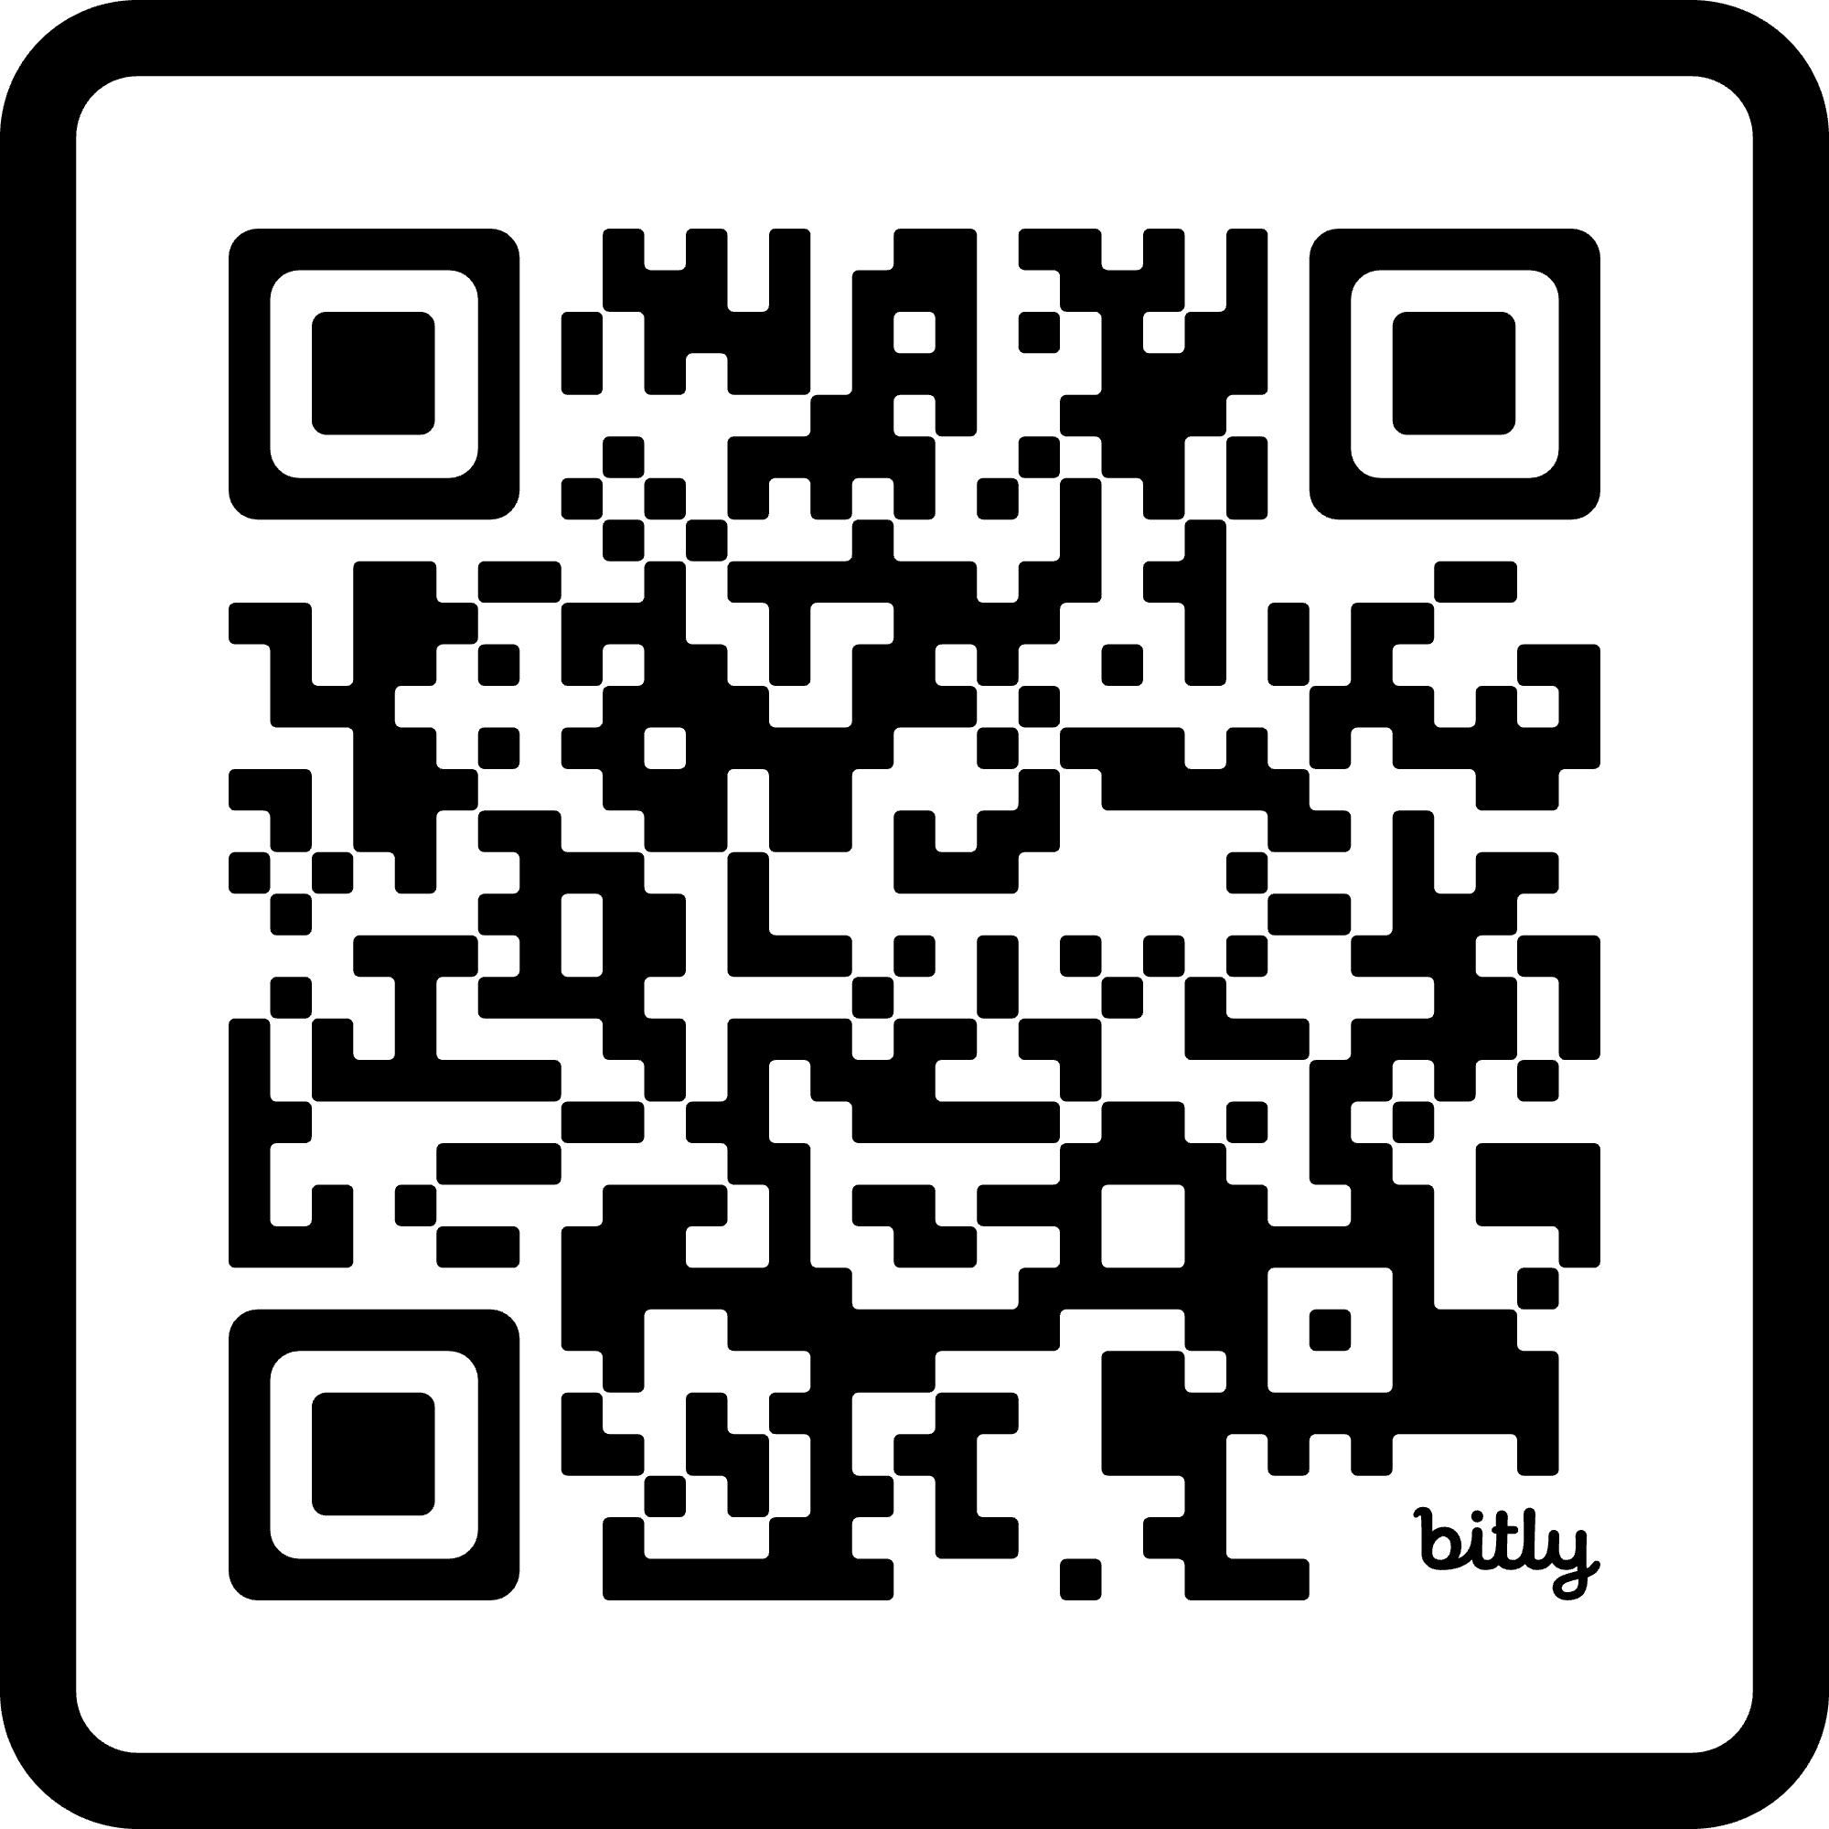
Next Steps for Getting Started
Schedule a consultation via info@gobrandwoven.com
or by scanning the QR code

Slide 27
www.gobrandwoven.com

