Slide 1
EXPANDING BEYOND AMAZON US

Slide 2
CHRIS GRAY – CEO of BRANDWOVEN
18 Years experience working with large, premium brands
6 Years leading Brandwoven (Formerly Run AMZ)
Managed over $1.7B in collective consumer sales of sporting goods products across multiple channels
Experience in big box, specialty retail, 2-Step distribution and D2C channels

Slide 3
ABOUT BRANDWOVEN
28K
ASINS managed
$175M
Amazon sales managed per year
Brandwoven is a full-service marketplace management agency dedicated to helping premium brands thrive on Amazon, Walmart.com, Target.com, and other online marketplaces.
Our services cover every corner of the digital marketplace including catalog management, digital merchandising, logistics, marketing, and more.
Our approach is consultative and we value long-term partnership and brand stewardship over everything else.
Learn more at www.gobrandwoven.com
$16.8M
Avg annual Amazon sales of Vendor Central brands
32
Staff

Slide 4
WHAT WE WILL COVER
Global Market Opportunities
When to Expand Beyond Amazon.com
Easy First Steps
Strengths and Opportunity on Various Platforms
Walmart.com
Target.com
Amazon CA/MX, EU, Japan and Australia

Slide 5
FRAMEWORK
Participants are muted and cameras turned off but feel free to ask questions
Use Q&A button at top right of screen at any time
We will try to answer questions real-time but may elect to wait until end of presentation
Presentation planned for 40-50 minutes
Link to the webinar will be posted online within 48 hours

Slide 6
GLOBAL MARKETPLACE OPPORTUNITIES

Slide 7
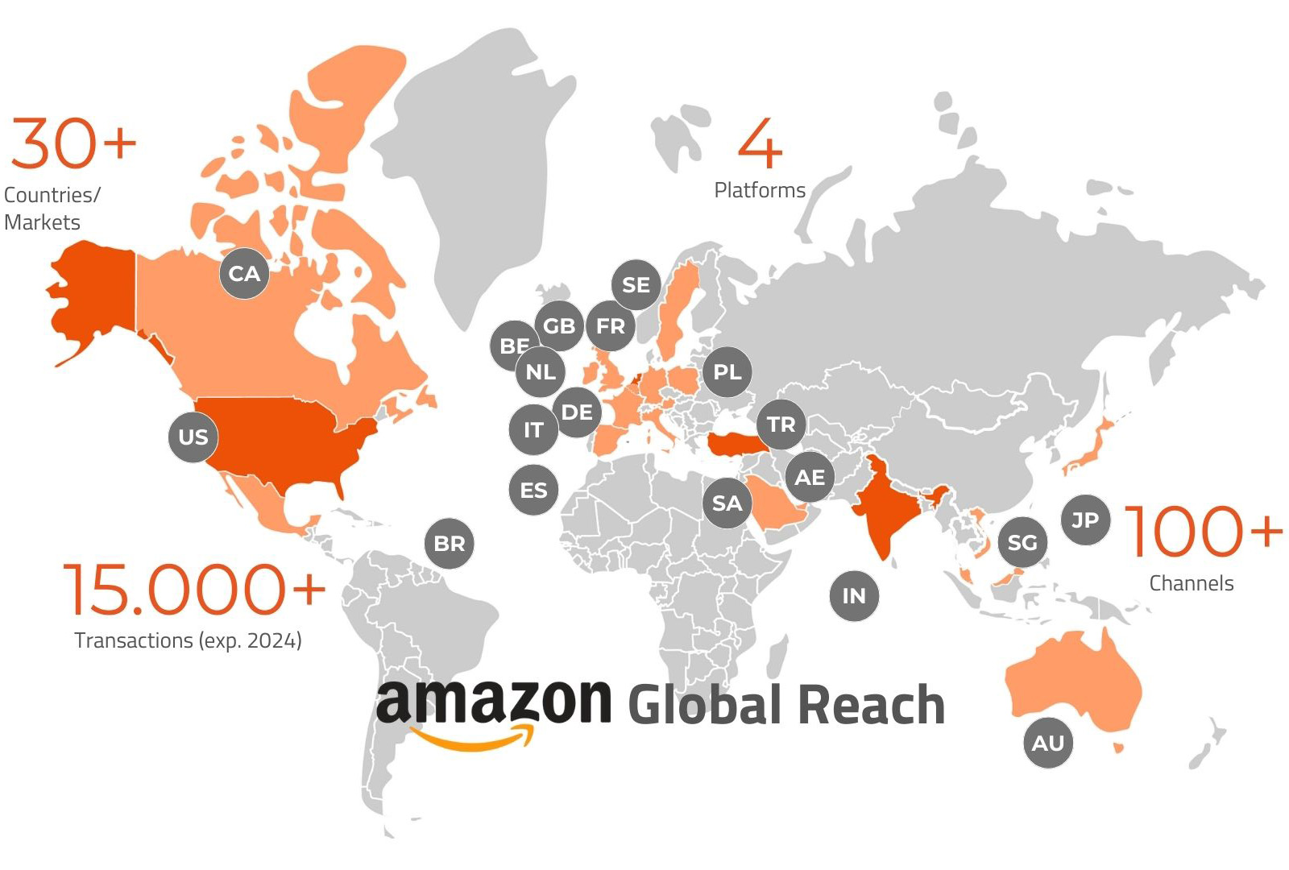
A WORLD OF OPTIONS
OTHER MARKETS
Source: NXT GROUP

Slide 8
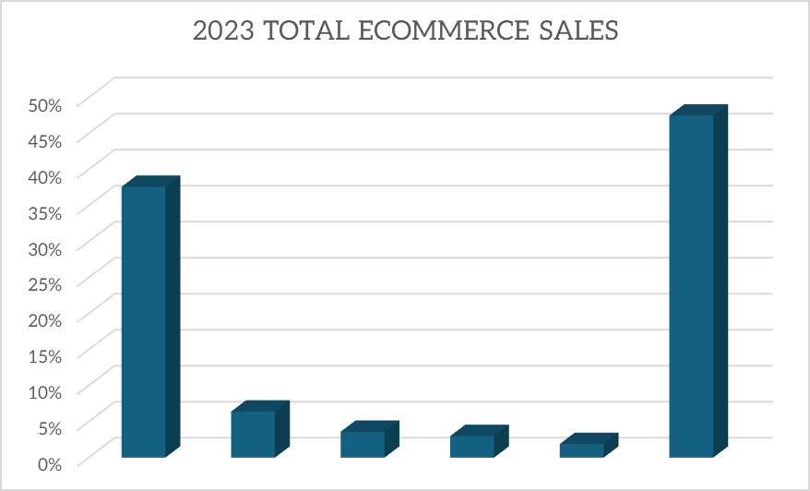
A WORLD OF OPTIONS
All Others

Slide 9
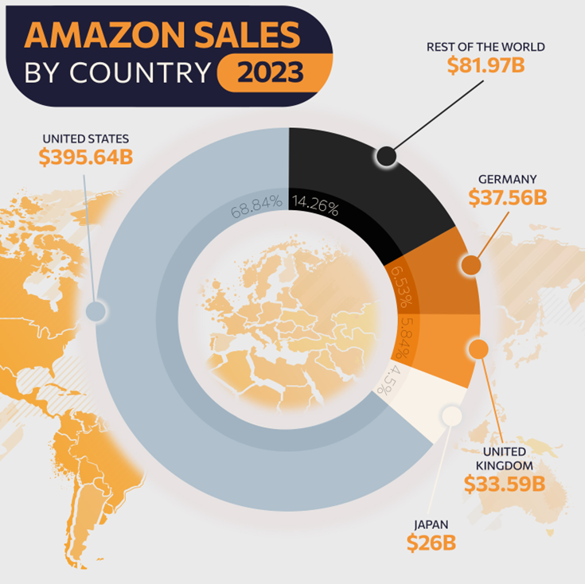
Scale of Amazon
KEY STATS
Over 70% of Sales Occurring in US
Germany Next Largest Market with <7% of Sales
Over 180M Users in EU
Notes:
Example of when product went to sister-in-law

Slide 10
DECIDING HOW AND WHERE TO EXPAND

Slide 11
DECISION POINTS
Product Category
Brand Goals & Target Consumer
Size of Opportunity

Slide 12
CONSIDERING PRODUCTS & COMPETITION
Walmart.com
Target.com
Amazon.ca/Amazon.mx
Amazon EU
Amazon.co.jp
CATEGORY STRENGTHS
Grocery
CPG
Home & Kitchen
Oversize Items (pick up in store)
CATEGORY WEAKNESSES
Hardlines
Premium Products
CATEGORY STRENGTHS
Home & Kitchen
Oversize Items (pick up in store)
CATEGORY WEAKNESSES
Hardlines
Premium Products
CATEGORY STRENGTHS
Market Specific Products
Electronics
Kitchen
CATEGORY WEAKNESSES
Oversize
CATEGORY STRENGTHS
Multiple Categories
Brands with Existing EU Demand
CATEGORY WEAKNESSES
Oversize
CATEGORY STRENGTHS
Consumer Electronics
Fashion & Apparel
Baby Products
CATEGORY WEAKNESSES
Grocery
Children’s Toys

Slide 13
CONSIDERING AUDIENCE AND BRANDING
Does New Marketplace Deliver a New Audience?
Does Marketplace Reflect Your Brand Voice & Value?
Does New Marketplace Cater to Your Target Market?

Slide 14
CONSIDERING SIZE OF OPPORTUNITY
Market | Share | Brand A | Brand B
Amazon.US | 67% | $ 30,000,000.00 | $ 2,000,000.00
Projected Opportunity |  | Brand A | Brand B
Amazon.EU | 13% | $ 5,625,000.00 | $ 375,000.00
Amazon.JP | 4% | $ 1,950,000.00 | $ 130,000.00
Walmart.com | 14% | $ 6,375,000.00 | $ 425,000.00
Target.com | 2% | $ 750,000.00 | $ 50,000.00
Brands who are still scaling on Amazon US need to be selective in where money and time are invested.

Slide 15
EASY FIRST STEPS
FBA EXPORTS
VENDOR CENTRAL BRANDS
FBA REMOTE FULFILLMENT
Within Seller Central, brands can make products available to select international markets while Amazon manages importation & tax
If enrolled, allows FBA inventory from the US to fill orders for customers in CA and MX
If utilizing Vendor Central, Amazon automatically makes product available for export, or for purchase by other marketplaces. This is controlled by Amazon and is often unknown to the brand

Slide 16
MARKETPLACES
Opportunities and Challenges of Individual Marketplaces

Slide 17
CONSIDERING MULTIPLE MARKETPLACES
Marketplace | Expand If | Avoid If | Biggest Opportunity | Biggest Challenge
Walmart.com | - You have in-store placement - You're in the grocery or CPG Category | - You are a premium brand - You aren't in Grocery or CPG | - Growing with interesting ways to reach consumers not found on Amazon | - Changing quickly and prone to errors
Target.com | - You have in-store placement - You're in the home and household category | - You are not a branded product (generic) - You are less than $10M in overall marketplace revenue | - Curated assortment reduces competition | - Very few sellers, invite only
Amazon CA/MX | - It's easy using Amazon programs - You have a product popular in the market. | - You have limited resources to manage marketplace - You have low ASP items | - Easy addition to current efforts | - Generating volume to justify management expense
Amazon International Markets | - You already have an international brand - You have existing distribution | - You have limited resources to manage marketplace - You are not already selling inside EU and UK | - Largest business segment on Amazon outside of US market - Growing rapidly | - Cost and complexity to manager - each marketplace requires individual attention

Slide 18
Interested in Learning More?
Schedule a consultation via info@gobrandwoven.com
or by scanning the QR code

Slide 19
www.gobrandwoven.com

